Slide 1

Dominick’s Grocery Store
Nabeel Keloth
Walinsara Chinjaturapatr
Xoshil Serrano
Notes:
Good Afternoon today we will be presenting Dominick Grocery Store
Team 5 Nabeel, Walinsara, Xoshil

Slide 2


Agenda
01
02
04
03
05
06
Background
Objectives
Methodology
Results
Insights
Recommendation
Notes:
In today’s agenda we will start with the company’s background, then
Explore objectives, continue with methodology, to achieve the results, continuing with the insights and concluding with the recommendations.

Slide 3
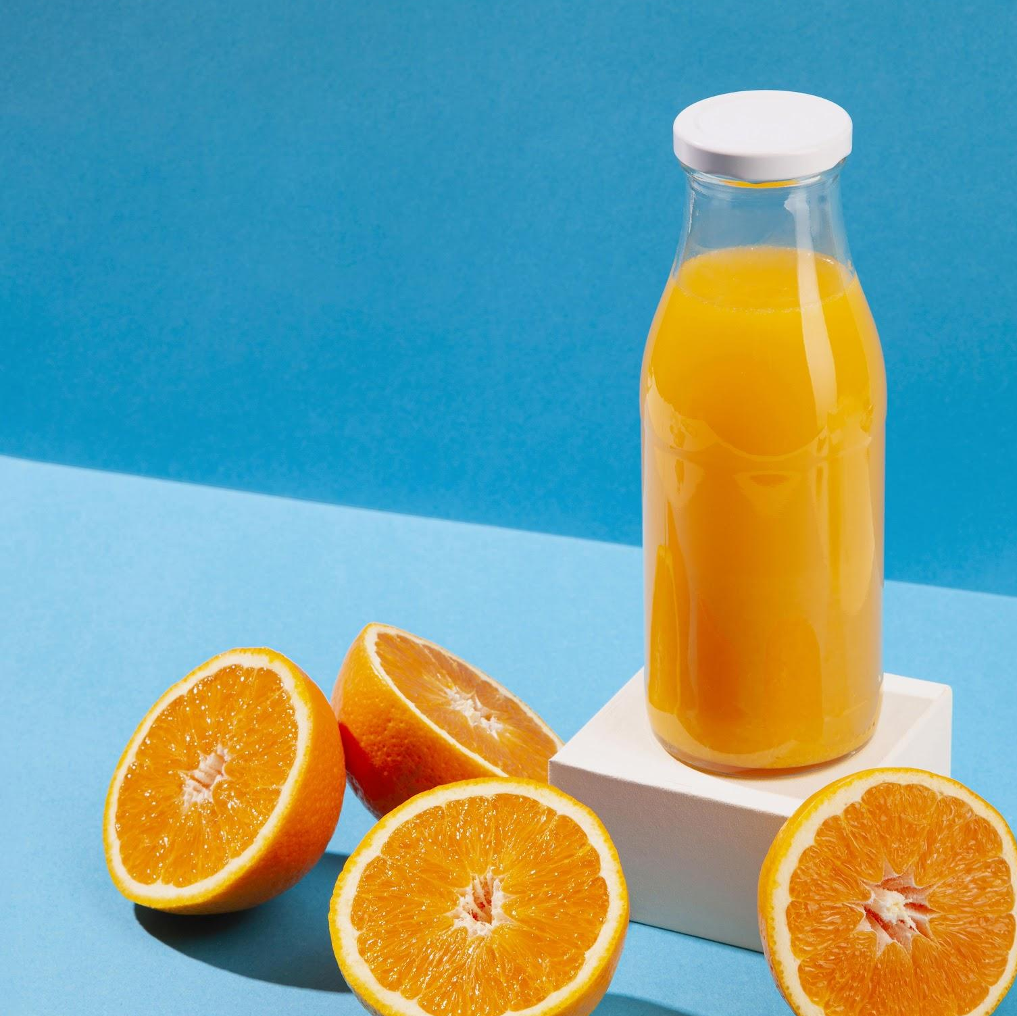
Background
Dominick’s is a grocery store chain founded in 1918
A division of Safeway Inc
Established in chicago
Notes:
Dominick’s grocery store chain is a division of Safeway Inc
founded in 1918 that was established in Chicago

Slide 4

Objectives
Understand what are the sale patterns
Set optimal prices
Avoid product cannibalization
Maximize Profit by 20%
Provide suitable marketing strategy
Notes:
We want to understand what the sale patterns are using the historical data
With the results we achieve we plan to avoid product cannibalization
To increase the company’s profits and revenues we want to set the right prices as well as improve the marketing strategy to increase sales

Slide 5
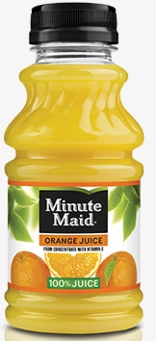
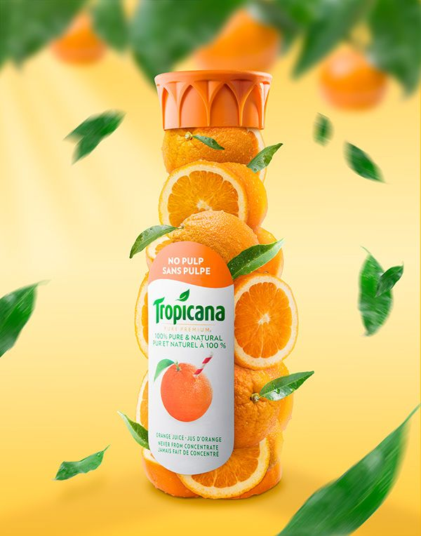
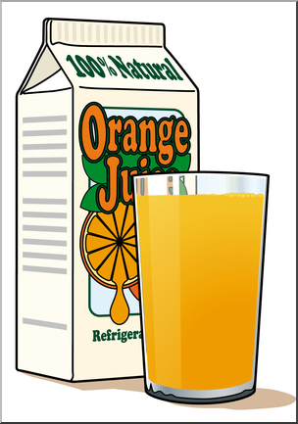
Products
Tropicana Prem 64 OZ
Dominick’s 64 OZ
Tropicana Prem 96 OZ
Tropicana 64 OZ
Minute Maid 64 OZ
Notes:
The 5 products that are taken into account based on the data will be:
Two premium tropicana use one of 64oz and the other 96 oz, the third will be tropicana orange juice of 64oz, fourth will be minute maid of 64oz and last product will be Dominick’s own orange use of 64oz

Slide 6
Historical Data Overview
 | Tropicana Prem 64 OZ | Tropicana Prem 96 OZ | Tropicana 64 OZ | Minute Maid 64 OZ | Dominick’s 64 OZ
Avg Profits | $10,371 | $15,365 | $6,109 | $7,331 | $4,558
Avg Gross Margin | 0.28 | 0.29 | 0.29 | 0.25 | 0.29
Avg Price | $2.90 | $4.80 | $2.30 | $2.27 | $1.71
Notes:
Historical Data Overview
The Avg profit, gross margin and price from the five products from dataset

Slide 7
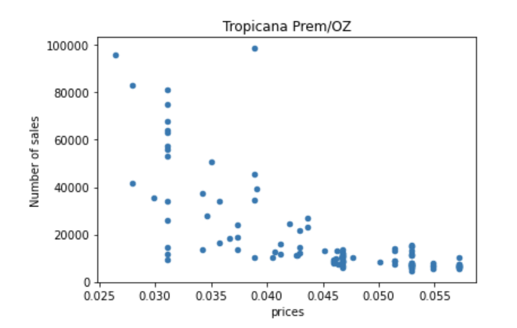
Sale Patterns
Notes:
Sales pattern
The following scatterplot represents the number of sales of the products as well as the prices from lowest to highest based on product Tropicana premium oz

Slide 8
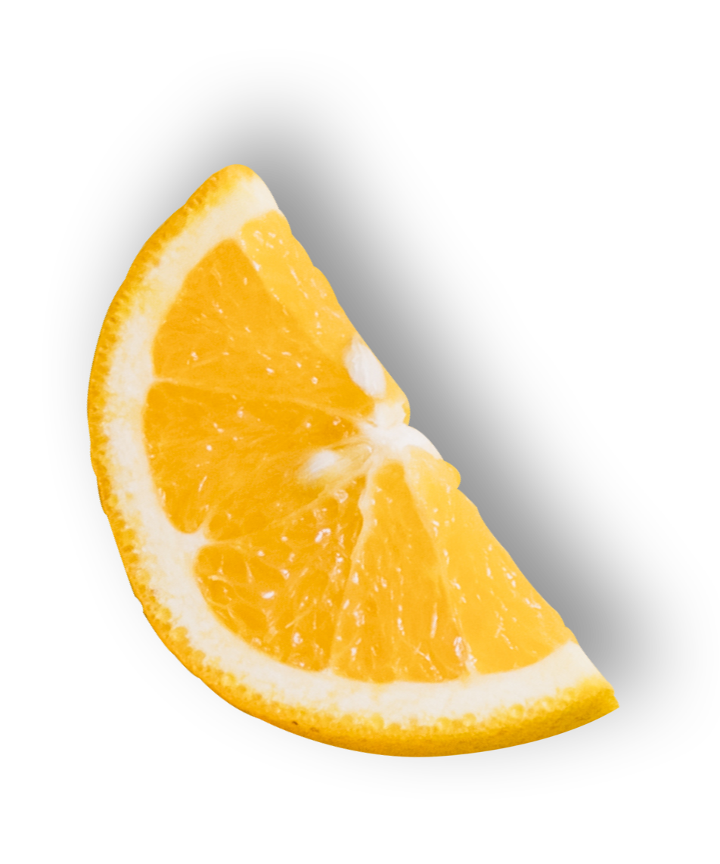
Methodology
01
02
03
Clean Data
Regression
Monte Carlo Simulation

Slide 9
Methodology
Clean data
Regression
Change display and feature to dummy variables
Transformation to Natural log
Gross margin
Sales

Slide 10
Methodology
Simulation
Setting Price
Predicting price by using the minimum and maximum from the historical data
100,000 times
Loop over the formula

Slide 11
Methodology
Sales
𝐿𝑁(𝑠𝑎𝑙𝑒𝑠 i) = 𝛽0 + 𝛽1 𝐿𝑁(𝑝𝑟𝑖𝑐𝑒1) +𝛽2 𝐿𝑁(𝑝𝑟𝑖𝑐𝑒2) + 𝛽3 𝐿𝑁(𝑝𝑟𝑖𝑐𝑒3) + 𝛽4 𝐿𝑁(𝑝𝑟𝑖𝑐𝑒4) + 𝛽4 𝐿𝑁(𝑝𝑟𝑖𝑐𝑒4) + 𝛽5 𝐿𝑁(𝑝𝑟𝑖𝑐𝑒5) + 𝛽6 𝑑𝑖𝑠𝑝𝑙𝑎𝑦 i + 𝛽7𝑓𝑒𝑎𝑡 i
Gross Margin
Gross Margin i = 𝛽0 + 𝛽1 (price i)
Profit
Profit i = ( price i)(Gross Margin i)((LN_sales i)*(unit i))

Slide 12
Comparing Simulation Results
Items |  | Scenario 1 | Scenario 2 (Optimal) | Scenario 3 | Scenario 4 | Scenario 5 | Scenario 6
Price | Tropicana Prem 64 OZ​ | $ 3.66 | $ 3.56 | $ 3.66 | $ 3.66 | $ 3.56 | $ 3.66
 | Tropicana Prem 96OZ​ | $ 5.76 | $ 5.68 | $ 5.76 | $ 5.76 | $ 5.68 | $ 5.76
 | Tropicana 64 OZ​ | $ 2.76 | $ 1.50 | $ 2.76 | $ 2.76 | $ 1.50 | $ 2.76
 | Minute Maid 64 OZ​ | $ 2.96 | $ 2.96 | $ 2.96 | $ 2.96 | $ 2.96 | $ 2.96
 | Dominik’s 64 OZ​​ | $ 1.26 | $ 2.30 | $ 1.26 | $ 1.26 | $ 2.30 | $ 1.26
Gross Margin | Tropicana Prem 64 OZ​ | 40% | 39% | 40% | 40% | 39% | 40%
 | Tropicana Prem 96OZ​ | 36% | 35% | 36% | 36% | 35% | 36%
 | Tropicana 64 OZ​ | 39% | 13% | 39% | 39% | 13% | 39%
 | Minute Maid 64 OZ​ | 39% | 38% | 39% | 39% | 38% | 39%
 | Dominik’s 64 OZ​​ | 16% | 46% | 16% | 16% | 46% | 16%
Total | Revenue | $ 130,244 | $ 302,259 | $ 160,794 | $ 159,789 | $ 299,375 | $ 165,513
 | Sales | 44908 | 165078 | 57231 | 54577 | 164092 | 60305
 | Marketing methods | 0 | 2 | 2 | 2 | 1 | 2
 | Profit | $ 44,106 | $ 60,195 | $ 54,578 | $ 56,070 | $ 59,094 | $ 55,513

Slide 13
Results: Optimized Sales and Revenue
Products | Historical |  | Optimized
 | Avg Revenue | Avg sales | Sales | Revenue ​
Tropicana Prem 64 OZ​ | $ 46,838 | 18879 | 5371 | $ 19,112
Tropicana Prem 96OZ​ | $ 55,066 | 11763 | 8150 | $ 46,269
Tropicana 64 OZ​ | $ 29,586 | 14898 | 144452 | $ 216,991
Minute Maid 64 OZ​ | $ 36,707 | 18481 | 5672 | $ 16,595
Dominik’s 64 OZ​​ | $ 22,432 | 15359 | 1433 | $ 3,291
Total | $ 190,628 | 79380 | 165078 | $ 302,259

Slide 14
Results: Optimized profit
Products | Historical |  |  | Optimized
 | Avg Price | Avg Gross margin | Avg Profit | Price | Gross Margin | Profit
Tropicana Prem 64 OZ​ | $ 2.90 | 28% | $ 10,371 | $ 3.56 | 39% | $ 7,395
Tropicana Prem 96OZ​ | $ 4.80 | 29% | $ 15,365 | $ 5.68 | 35% | $ 16,297
Tropicana 64 OZ​ | $ 2.30 | 29% | $ 6,109 | $ 1.50 | 13% | $ 28,653
Minute Maid 64 OZ​ | $ 2.27 | 25% | $ 7,331 | $ 2.96 | 38% | $ 6,336
Dominik’s 64 OZ​​ | $ 1.71 | 29% | $ 4,858 | $ 2.30 | 46% | $ 1,516
Total |  |  | $ 44,035 | 37% increase in total profit |  | $ 60,195
Marketing methods: Featuring Tropicana 64 oz and displaying Minute maid 64 oz
Optimized Profit

Slide 15
Insights
37% increase in optimal profit when compared to the historical average.
The featuring Tropicana 64 OZ​ has high profit with the lowest gross margin.
Dominik’s 64 OZ​​ has fewer sales with the highest gross margin.
To generate higher profit than the historical average, Dominick’s should perform at least one marketing method in a week.
Featuring a product in the brochure is profitable.
Notes:
When Tropicana 64 OZ features, the price of the product goes down. It will attract more consumers and increase profit. In this case, we can also assume that the product is on sale.

Slide 16
Recommendation
Optimal Marketing strategy for 5 weeks. Following the same pattern will benefit the company to generate the most optimal profit with the orange juices.
Marketing strategy | Week 1 | Week 2 | Week 3 | Week 4 | Week 5
Feature | Tropicana 64 OZ​ | Tropicana Prem 64 OZ​ | Minute Maid 64 OZ​ | Tropicana 64 OZ​ | Minute Maid 64 OZ​
Display | Minute Maid 64 OZ​ | Dominik’s 64 OZ​​ | Tropicana Prem 94 OZ​ | - | Dominik’s 64 OZ​​
Profit | $ 60,195 | $ 54,578 | $ 56,070 | $ 59,094 | $ 55,513
Increase in avg hist | 37% | 24% | 27% | 34% | 26%

Slide 17
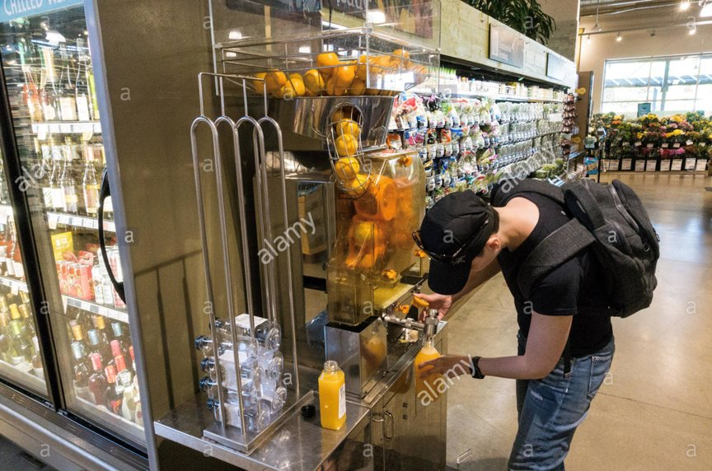
Recommendations
Potential marketing methods in future:
Online advertising
In-store samples
Provide more options for customers

Slide 18
That's it
Thank you for your time and attention!

